Slide 1
Network Administration
Encryption
The process of making information un-readable to protect it from unauthorized viewing or use
Microsoft used EFS technique for encryption
The EFS (Encrypted File System) provides encryption for data in NTFS files stored on disk
This encryption is public key–based

Slide 2
Network Administration
EFS
Windows 7 includes the encrypting file system (EFS), which allows users to encrypt and decrypt files that are stored on an NTFS volume
This technology is only available in the Professional, Enterprise, and Ultimate editions of Windows 7
By using EFS, folders and files are kept secure against intruders who might gain unauthorized physical access to the device
EFS allows users to encrypt NTFS files by using a strong public key–based cryptographic scheme that encrypts all files in a folder

Slide 3
Network Administration
EFS uses a process known as public key encryption. In public key encryption, a user has 2 keys: a public key, also known as a certificate, and a private key
The public key is kept in the computer’s store and accessible to everyone. Users can use the public key to encrypt data
The private key is kept in the user’s private certificate (in LSDB with its user account) store and can only be used by the user. The private key decrypts data which has been encrypted using the public key

Slide 4
Network Administration
NTFS permissions
To specify which users and groups can access files and folders and what they can do with the contents of the files or folders
NTFS permissions are available only on NTFS volumes
NTFS security is effective whether a user accesses the file or folder at the local computer or over the network.

Slide 5
Network Administration
Permissions
Permissions are authorizations to perform specific operations on specific objects
Control what users can do with a resource such as a folder, a file, or another resource
When you assign permissions, you allow users to gain access to a resource and you define the type of access that they have
The owner of an object or any user who has the necessary rights to modify permissions can apply permissions to NTFS objects

Slide 6
Network Administration
Each file or folder that created on NTFS volume has Access Control List (ACL)
Access control consists of rights and permissions
A right (also referred to as a privilege) is an authorization to perform a specific action means perform system tasks, such as changing the time on a computer and backing up or restoring files or shut the computer etc.
Design Goals for Access Control
Basic security strategy suggests that you provide each user and group with the minimum level of permissions needed for job functionality

Slide 7
Network Administration
Applying NTFS Permissions
NTFS permissions control access to NTFS files and folders
The person who owns the object has complete control over the object
You configure access by allowing or denying NTFS permissions to users and groups
Denied option has priority over allow option

Slide 8
Network Administration
NTFS File Permissions:
NTFS file permissions are used to control the access that a user, group, or application has to files
NTFS Folder Permissions:
NTFS Folder permissions determine the access that is granted to a folder and the files and subfolders within that folder
These permissions can be assigned to a user or group

Slide 9
Network Administration
READ
Read permission allows a user to read the files, list the contents of folders, subfolders and volumes, and read the attributes, permissions and ownership
A user with only Read permission will not able to change the contents of the file or folder
WRITE
Write permission allows the same as Read, but additionally allows the user to modify and create files and subfolders as well as change attributes

Slide 10
Network Administration
READ AND EXECUTE
Read and Execute permission allows the same as Read, but additionally allows users to run applications
MODIFY
Modify permission allows the same as Read, Write and Read and Execute combined, but additionally allows deleting

Slide 11
Network Administration
LIST CONTENTS
List Contents permission applies to folders only
It allows user to read files and list the contents of folders and volumes
Users with this permissions can see the files and folders, but cannot read or modify them nor can the create new files and folders

Slide 12
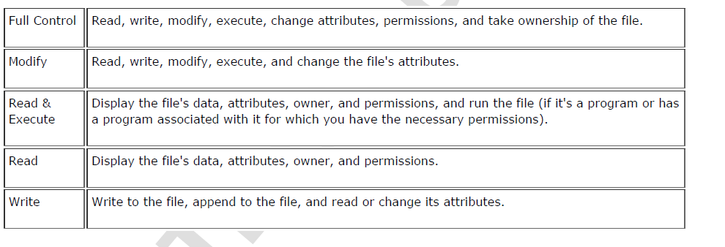
Network Administration
NTFS File Permissions

Slide 13
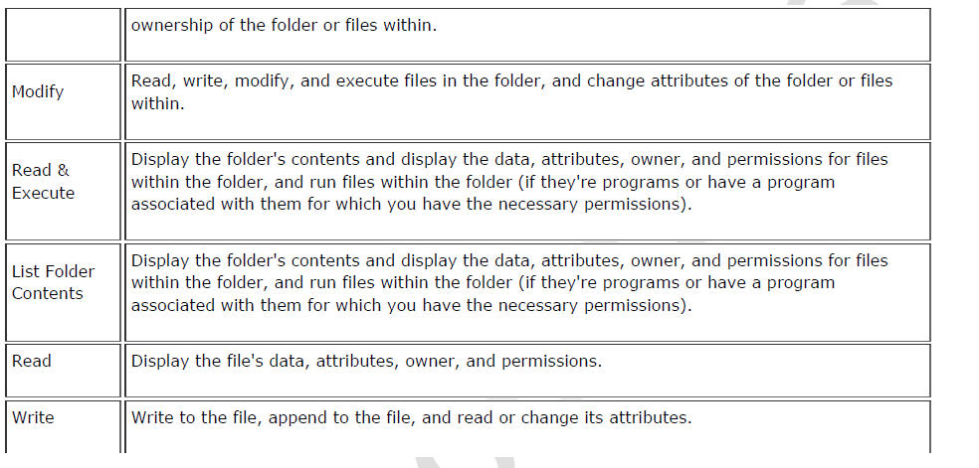
Network Administration

Slide 14
Network Administration
Permission Inheritance
Besides explicitly assigned permissions on a file or folder, it may inherit permissions from its parent folder (up to the root folder, which is the volume itself)
By default, permissions set on a folder are automatically inherited by all files and subfolders in it. This simplifies administration but is not always desired

Slide 15
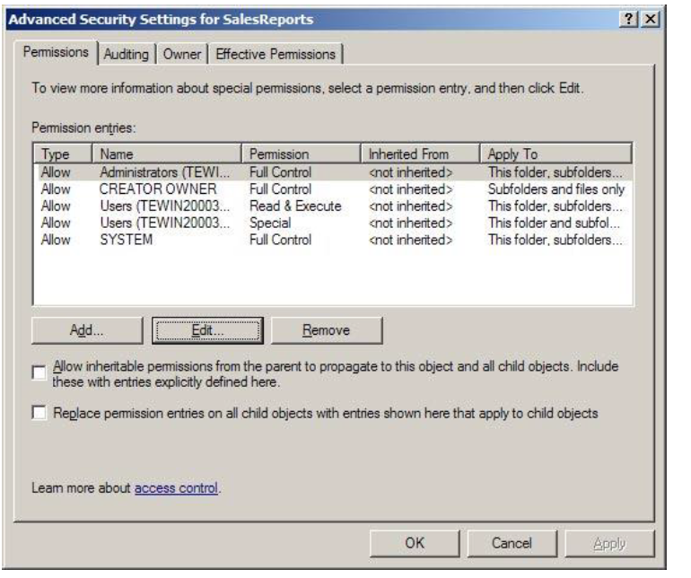
Network Administration

Slide 16
Network Administration
In the image, you can see the following two options
Allow inheritable permissions from the parent to propagate to this object and all child objects. Include these with entries explicitly defined here
When this option is cleared, the file or folder will not inherit permissions from the parent folder
Replace permission entries on all child objects with entries shown here that apply to child objects
This option will actually reset the permissions on child objects (files and subfolders) to make sure they inherit the permissions from this folder and those permissions are not overridden by permissions explicitly assigned on child objects

Slide 17
Network Administration
Taking Ownership of an NTFS File
By default, the creator of a folder or a file on NTFS volumes is the owner of that object. This enables that user to set the permissions related to that file or folder
Administrators can take ownership of any file or folder
Administrators can also grant ownership of files or folders to a group or user

Slide 18
Network Administration
Disk Quotas
Tracks disk quotas and controls disk usage on a per-user base
Disk quotas can be applied only to NTFS volumes
Can set disk quotas, quota thresholds, and quota limits for all users and for individual users
Quotas give you the advantage to limit the amount of hard disk space that a user can have on a volume or partition
By default, quotas are disabled
To enable quotas, check the Enable Quota Management check box

Slide 19
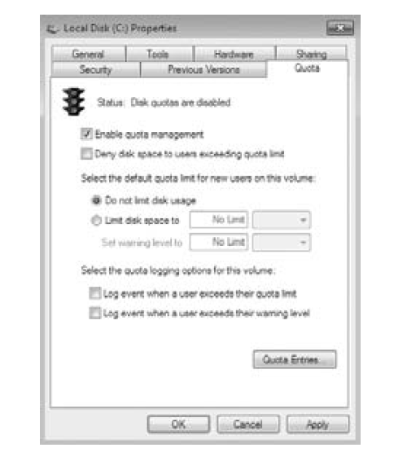
Network Administration

Slide 20
Network Administration
The Deny Disk Space To Users Exceeding Quota Limit check box is another option
When this box is enabled, any user who exceeds their quota limit will be denied disk storage
You can choose not to enable this option, which allows you to just monitor the quotas
You also have the ability to set the quota limit and warning size

